Slide 1
TIGER AND ITS CONSERVATION
BY VYOM VINAY MAHAJAN

Slide 2
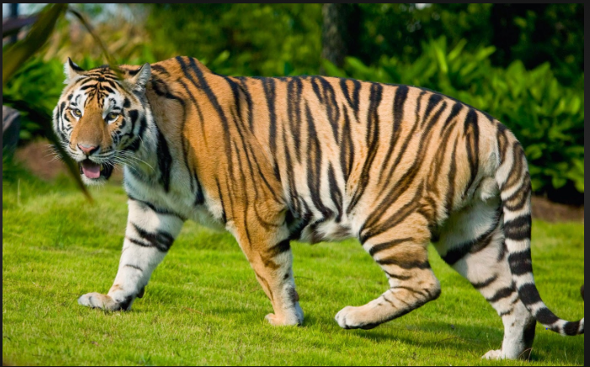

What are tigers?
The tiger is the largest cat species , most recognizable for its pattern of dark vertical stripes on reddish orange fur with a lighter underside. The species is classified into the genus Panthera with the lion, leopard, jaguar and snow leopard.

Slide 3
Tiger Conservation
The tiger is an iconic species. Tiger conservation attempts to prevent the animal from becoming extinct and preserving its natural habitat. THE CONVENTION ON INTERNATIONAL TRADE IN ENDANGERED SPECIES OF WILD FAUNA AND FLORA (CITES) has played a crucial role in improving efforts for tiger conservation.

Slide 4


Slide 5
CITES
Cites is an international governance network employing tools and measures which adapt and become more efficient with time. One measure specifically at protecting the tiger is visible in the network’s efforts to ban the trade of tiger or tiger derivatives. Cites members have agreed to adhere an international trade ban.

Slide 6
Tiger conservation in India
PROJECT TIGER, was started in 1972 to protect tigers and their habitats in India. At the beginning of the 20th century the first estimate was about 40,000 tigers. Then yet an Indian tiger census was conducted in 1972 and revealed 1827 remaining tigers in India. In 1970 the national ban on tiger hunting was imposed, and in 1972 the WILDLIFE PROTECTION ACT came to force. The framework was then set to formulate a project for tiger conservation with an ecological approach. Launched on 1st April became the most successful project of the modern time. The project aims at tiger conservation in tiger reserves which are representatives of various bio-geographical regions falling in India. Today there are 27 project tiger wildlife reserves or more in India, covering an area of 37,761km2.

Slide 7
NAMES OF THE RESERVES IN INDIA
Assam – Manas, Kaziranga, Nameri
Andhra Pradesh/Telangana – Nagarjunsagar
Arunachal Pradesh – Namdapha, Pakke
Bihar – Valmiki
Chhattisgarh – Indravati, Undanti-Sitandadi, Achanakmar
Jharkhand – Palamau
Kerala – Periyar, Paranbikulam
Karnataka – Bandipur, Bhandra, Dandeli-Anshi, Nagarhole
Maharashtra – Tadobi-Andhari, Melghat, Pench, Sayhadri
Madhya Pradesh – Bandhavgarh, Kanha, Satpura, Panna, Sanjay-Dubri, Pench
Mizoram – Dampa

Slide 8
NAMES OF THE RESERVES IN INDIA
Orrisa – Satkosia, Simlipal
Rajasthan – Ramthombhore, Sariska
Tamil Nadu – Kalakad-Mundanturai, Mudumalai, Anamalai
Uttarakhand – Corbett
Uttar Pradesh – Dudhwa
West Bengal – Buxa, Sundarban

